Slide 1
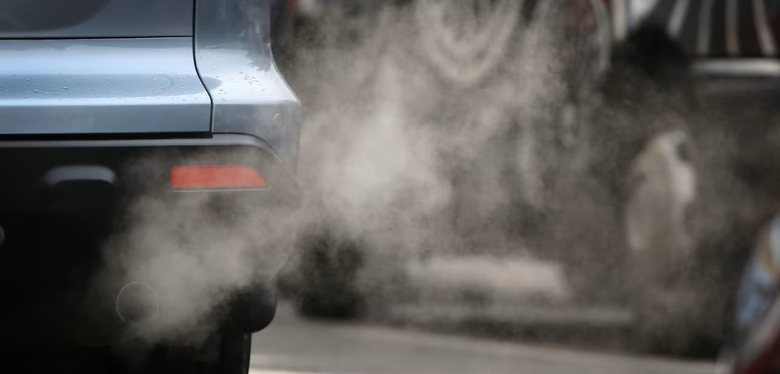

Prediction of CO2 Emission from Vehicles

Slide 2

Introduction
Carbon dioxide (CO2) emissions from vehicles contribute to climate change
The transportation sector is responsible for around one-fourth of global CO2 emissions
Governments and organizations are working to reduce emissions by promoting cleaner vehicles
Providing consumers with information on the environmental impact of their vehicle choices can encourage the adoption of cleaner vehicles

Slide 3

Objectives
Train the system on a dataset of vehicle features such as the number of cylinders, transmission type, fuel type, and fuel consumption in the city, highway, and combined scenarios
Develop a machine learning-based system that can predict the CO2 emissions of vehicles based on their features.
Identify the most prominent features that influence the CO2 emissions of vehicles.
Assist consumers in making more informed decisions about their vehicle choices.
Assist policymakers and manufacturers in developing more environmentally friendly vehicles.

Slide 4

Data Collection
The dataset used for this project is the Vehicle Emissions Dataset by Debajyoti Podder, available on Kaggle at https://www.kaggle.com/datasets/debajyotipodder/co2-emission-by-vehicles
The raw data for this dataset was obtained from the Canada Government website at https://open.canada.ca/data/en/dataset/98f1a129-f628-4ce4-b24d-6f16bf24dd64#wb-auto-6.

Slide 5
Data Set
The dataset contains information about 7385 vehicles , with the following fields:
Make: The company that manufactured the vehicle
Model: The model of the vehicle
Vehicle Class: The class of the vehicle based on its utility, capacity, and weight
Engine Size(L): The size of the engine used in liters
Cylinders: The number of cylinders in the engine
Transmission: The type of transmission and the number of gears
Fuel Type: The type of fuel used by the vehicle
Fuel Consumption City (L/100 km): The fuel consumption in city roads, measured in liters per 100 kilometers
Fuel Consumption Hwy (L/100 km): The fuel consumption on highways, measured in liters per 100 kilometers
Fuel Consumption Comb (L/100 km): The combined fuel consumption, calculated as 55% city and 45% highway, measured in liters per 100 kilometers
Fuel Consumption Comb (mpg): The combined fuel consumption, calculated as both city and highway, measured in miles per gallon (mpg)
CO2 Emissions(g/km): The tailpipe emissions of carbon dioxide, in grams per kilometer, for combined city and highway driving

Slide 6
Potential Features and Target Variable
Potential Features:
Fuel Consumption Comb (L/100 km) - Continuous
Fuel Consumption Comb (mpg) - Continuous
Fuel Type - Categorical
Fuel Consumption City (L/100 km) - Continuous
Fuel Consumption Hwy (L/100 km) - Continuous
Vehicle Class - Categorical
Cylinders - Continuous
Target Variable: CO2 Emissions (g/km) - Continuous

Slide 7
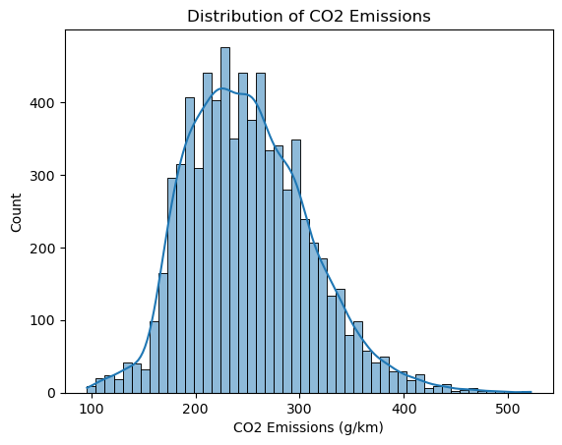
Exploratory Data Analysis
The distribution of the target variable CO2 emissions (g/km) appears to follow a normal distribution curve.
This suggests that the CO2 emissions values are evenly distributed around the mean value of the data, with no significant skewness or outliers.
This desirable property for a target variable in a regression problem suggests that the regression model will be able to capture the underlying patterns in the data more accurately.
After analyzing the data, we found that the number of vehicles emitting CO2 between 400 to 500 g/km (very high emission) and 100 to 150 g/km (low emission) is very low.
Most of the vehicles in the dataset fall under the average and high emission classes.
This highlights the importance of developing accurate CO2 emission prediction models that can help reduce the emissions of vehicles in these high-emission classes.

Slide 8
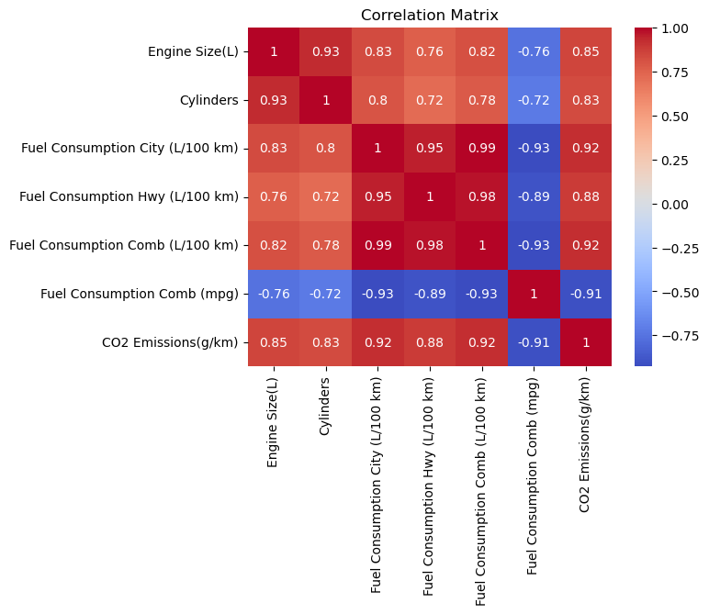
Correlation Analysis of Numerical Features and CO2 Emissions
There is a strong positive correlation between fuel consumption (all three) and CO2 emissions.
There is a positive correlation between engine size and cylinders with CO2 emissions, although not as strong as fuel consumption.
These findings suggest that reducing fuel consumption is the most effective way to reduce CO2 emissions, followed by reducing engine size and number of cylinders.
By understanding the relationship between these features and CO2 emissions, we can develop more accurate predictions of emissions for new vehicles and make more informed decisions about our vehicle choices.

Slide 9
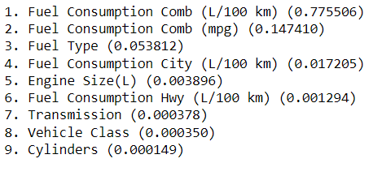
Feature Importance Analysis for Predicting CO2 Emissions
Fuel consumption in liters per 100 kilometers or miles per gallon is the most significant factor affecting CO2 emissions. This finding aligns with prior knowledge about the relationship between fuel consumption and CO2 emissions.
The fuel type also plays a role in CO2 emissions, with different types of fuel resulting in different levels of CO2 emissions.
Other features such as "Fuel Consumption City (L/100 km)", "Fuel Consumption Hwy (L/100 km)", "Fuel Consumption Comb (L/100 km)", and "Engine Size(L)" also have a strong linear relationship with CO2 emissions, as indicated by the correlation analysis.
A comprehensive understanding of the relationship between the features and the target variable can be obtained by considering both correlation analysis and feature importance analysis together.

Slide 10
Quartile Classification
In Canada, low-emission vehicles (LEV) are defined based on tailpipe emissions of greenhouse gases, including CO2, N2O, and CH4.
Low-emission vehicles: Any vehicle with CO2 emissions below 125 g/km for model year 2021.
Average CO2 emissions: In 2020, the range of 150 g/km to 224 g/km is an approximation of average emissions in Canada.
Very high emissions: Vehicles emitting more than 400 g/km of CO2 are considered to have "very high" emissions
Quartile classification:
Very High: Above 400 g/km
High: Between 225 g/km to 400 g/km
Average: Between 125 g/km to 224 g/km
Low: Below 125 g/km

Slide 11
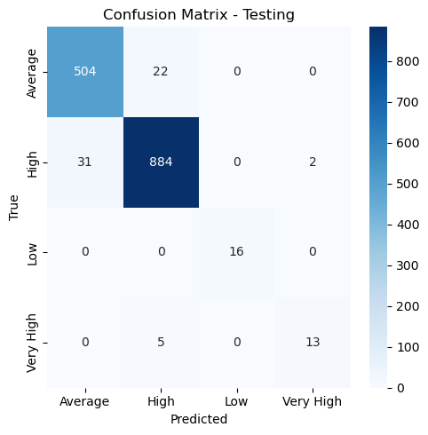
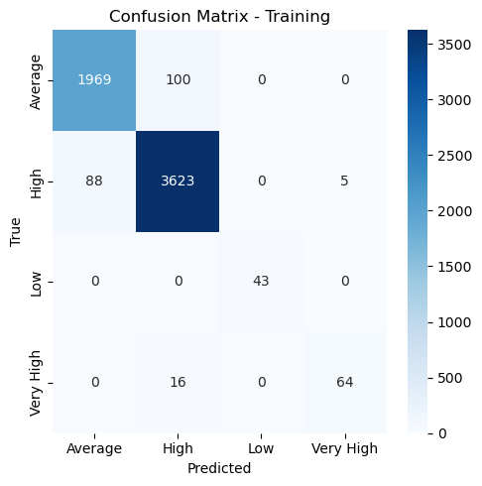
Logistic Regression Results for CO2 Emission Classification
Logistic regression was used to classify CO2 emissions into four classes based on their emission levels.
The confusion matrix and accuracy metrics were used to evaluate the performance of the logistic regression model.
The model achieved an overall testing accuracy of 0.9594, indicating good performance in predicting CO2 emission levels.
The CO2 emission levels were classified into four classes: Very High, High, Average, and Low, based on their emission levels.
Accuracy Metrics
Training Accuracy: 0.9646
Testing Accuracy: 0.9594
Precision: 0.9593
Recall: 0.9594
F1-score: 0.9592

Slide 12
Dividing Dataset into Subsets
Subdatasets are created based on the unique class labels in the "CO2 Class" column of the original dataframe, with each subdataset containing only the rows with the corresponding class label.
Four subdatasets are created, one for each class label:
Low – 59 instances with a mean of 112.52 for CO2 emissions
Average - 2595 instances with a mean of 193.98 for CO2 emissions
High - 4633 instances with a mean of 280.20 for CO2 emissions
Very High - 98 instances with a mean of 432.12 for CO2 emissions

Slide 13
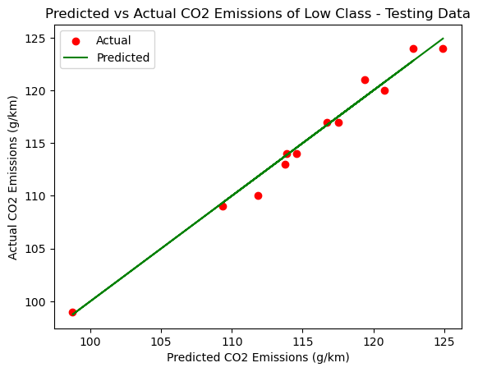
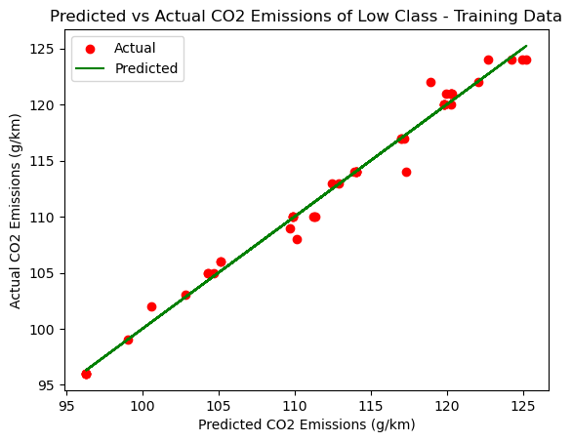
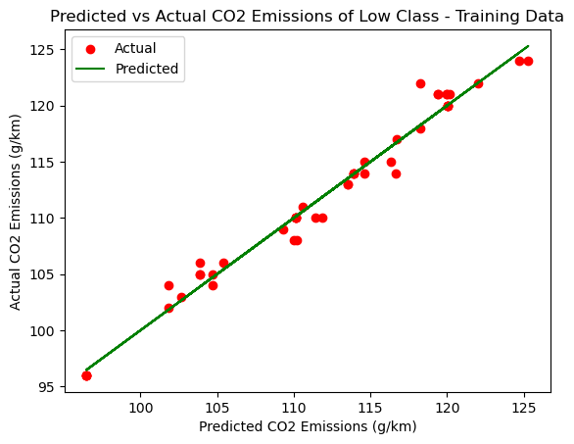
Low Data Set
Linear Regression
Training Set:
Mean Squared Error (MSE): 1.3277816884128628
R-squared (R2) Score: 0.978234863834194
Testing Set:
Mean Squared Error (MSE): 0.8595602664156976
R-squared (R2) Score: 0.9813701567784677
The low values of MSE indicate that the model has good accuracy in predicting the target variable. The high R-squared score suggests that the model explains a significant portion of the variance in the target variable. Overall, the model performs well on both the training and testing data for the low CO2 class.
Polynomial Regression
Training set:
MSE: 0.9138933402708229
R-squared score: 0.9866580946081062
Testing set :
MSE: 2.084260800895491
R-squared score: 0.9159760483401593
Lasso regression is used to prevent overfitting. The model performs well on training data with MSE of 0.91 and R-squared score of 0.98. On testing data, MSE is 2.08, and R-squared score is 0.91, but the model can still explain a significant variance. Overall, the model performs well and can generalize to new data.

Slide 14
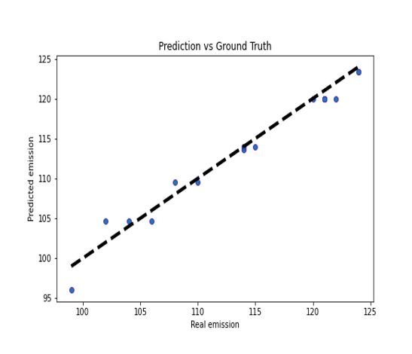
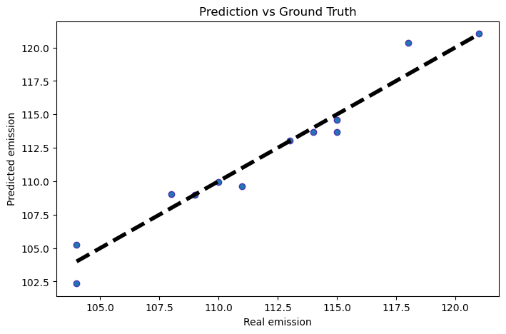
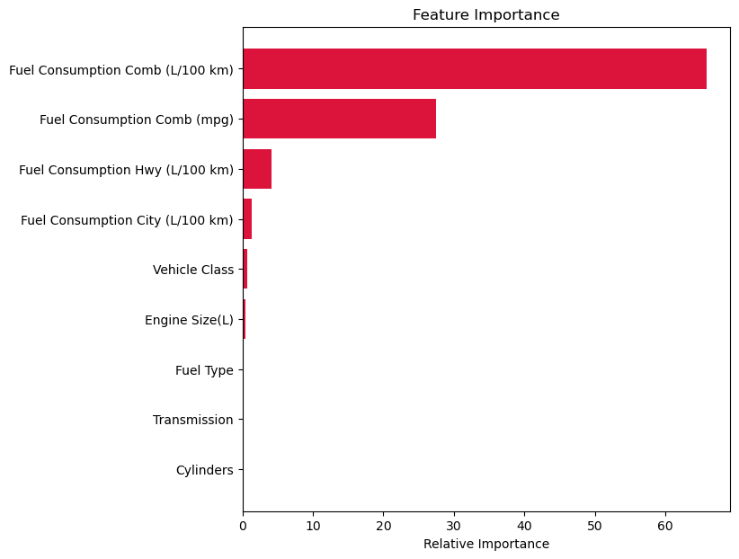
Low Data Set
Tree Regression
R^2 score for train dataset = 0.9981
R^2 score for test dataset = 0.9712
Mean Squared Error train and test: 1.724182413706 0.5588850174216
MSE decreased slightly for train and test sets, indicating a good sign. Test set R2 score decreased , but the model predicts the target variable values well. Let's check Bagged Regressor.
Bagged Regression
R^2 score for train dataset = 0.9972
R^2 score for test dataset = 0.9713
Mean Squared Error train and test: 1.716958070 0.3756634100
The bagged regressor with decision tree being able to capture non-linear relationships between the features and target variable.

Slide 15
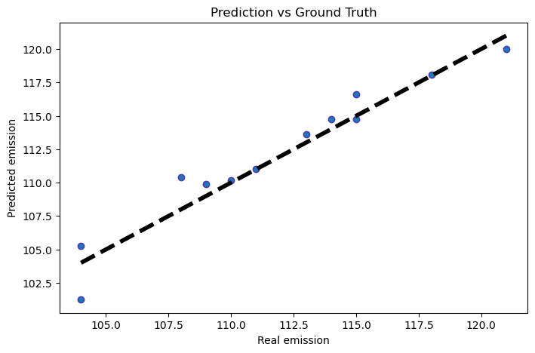
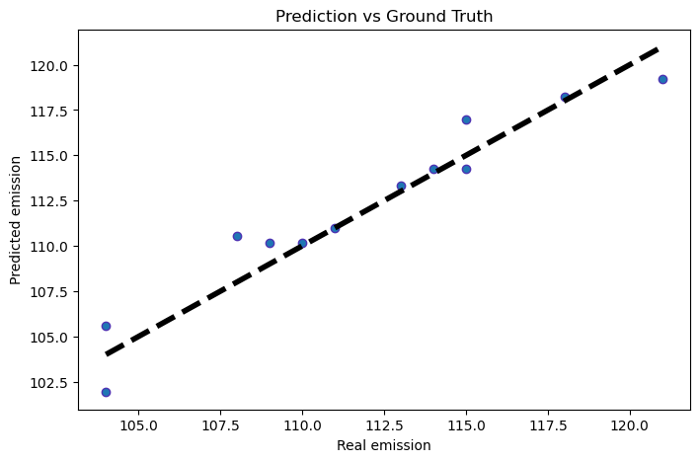
Low Data Set
Bagged Linear Regression
R^2 score for train dataset = 0.9811
R^2 score for test dataset = 0.9314
Mean Squared Error train and test: 1.7007208707934929 1.2937260296670892
Bagged linear regression shows good performance on low CO2 dataset, with R^2 score of 0.9314 and reasonable mean squared errors for train and test datasets, indicating no overfitting.
Bagged Polynomial Regression
R^2 score for train dataset = 0.9756
R^2 score for test dataset = 0.9239
Mean Squared Error train and test: 1.888530908213844 1.6709625823319287
It looks like the bagged regressor with polynomial regression as the base estimator has slightly lower performance compared to the bagged regressor with linear regression as the base estimator.

Slide 16
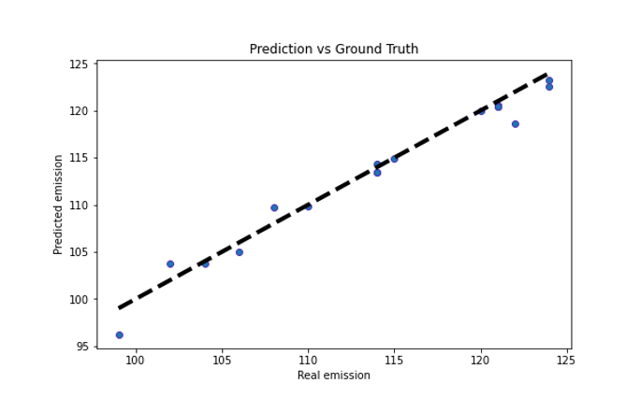
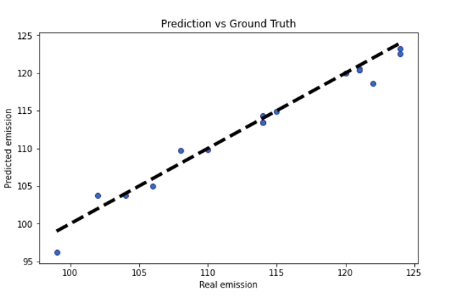
Low Data Set
Random Forest Regressor
R^2 score for train dataset = 0.9966
R^2 score for test dataset = 0.9781
Mean Squared Error train and test: 10.525333286949827 1.4452546755122195
Random forest regressor has high R^2 scores of 0.9966 for the train dataset and 0.9781 for the test dataset, with reasonable mean squared errors, indicating good performance and no overfitting.
XGBoost Regressor
R^2 score for train dataset = 0.9925
R^2 score for test dataset = 0.9736
Mean Squared Error train and test: 1.716958070265748 0.3756634102424038
XGBoost has lower R^2 scores than random forest but better mean squared errors, indicating better generalization.

Slide 17
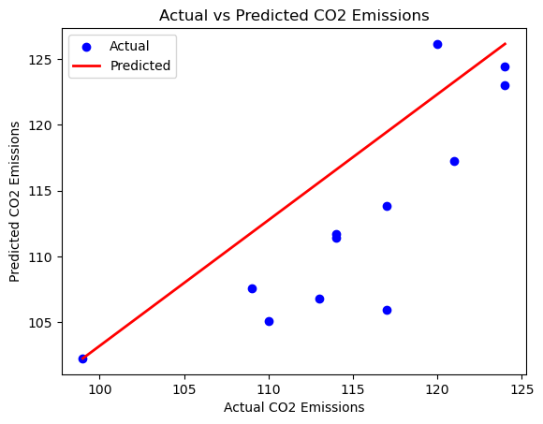
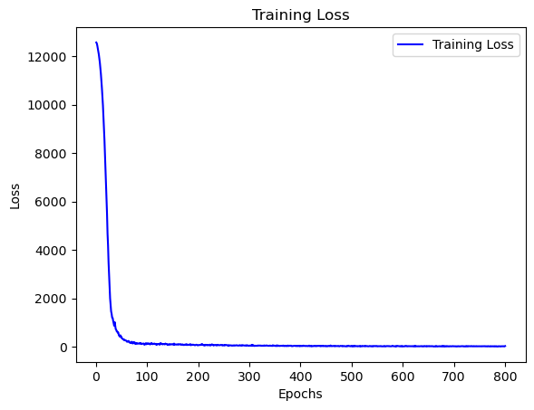
Low Data Set
Neural Networks
Training Set:
R-squared (R2) Score: 0.9203019135028471
Mean Squared Error (MSE): 4.861980143212466
Testing Set:
R-squared (R2) Score: 0.5072379691632056
Mean Squared Error (MSE): 22.7354925894421
The model's loss decreases rapidly during initial learning. It slows down later, indicating the model is still improving but at a slower rate. Eventually, the loss plateaus.
The graph suggests a simple model not capturing the overall pattern. The model may be underfitting, indicating insufficient training or training not being effective enough to learn the patterns and variations in the data.

Slide 18
LOW Dataset Results
MODEL | TRAIN_R2 | TEST_R2 | TRAIN_MSE | TEST_MSE
LINEAR | 0.97 | 0.98 | 1.32 | 0.85
POLYNOMIAL | 1.0 | 0.67 | 1.00 | 8.07
POLYNOMIAL WITH LASSO | 0.98 | 0.91 | 0.91 | 2.08
DECISION TREE | 0.99 | 0.96 | 0.02 | 1.92
DECISION TREE TUNED | 0.99 | 0.93 | 1.66 | 0.12
BAGGED LINEAR | 0.98 | 0.93 | 1.70 | 1.29
BAGGED POLYNOMIAL | 0.97 | 0.93 | 1.88 | 1.67
BAGGED DECISION TREE | 0.99 | 0.94 | 1.25 | 0.19
RANDOM FOREST | 0.99 | 0.95 | 1.11 | 0.17
XGBOOST | 1.0 | 0.87 | 3.09 | 2.72
XGBOOST TUNED | 0.99 | 0.91 | 2.22 | 0.05
NEURAL NETWORK | -196.43 | -273.87 | 12044.46 | 12682.62
NEURAL NETWORK TUNED | 0.92 | 0.50 | 4.86 | 22.73
After checking the results, we can identify that the Random Forest, Decision Tree Regressor, XGBoost, tuned XGBoost and Bagged Regressor with Linear, Polynomial Regression and Decision Tree as base estimator models are performing well. These models have high R2 values close to 1, which indicate a good fit of the model to the data, and low MSE values close to 0, which indicate that the model has small errors in the predictions. The neural network models do not perform as well as the other models, with negative R2 values and high MSE values, indicating poor performance.

Slide 19
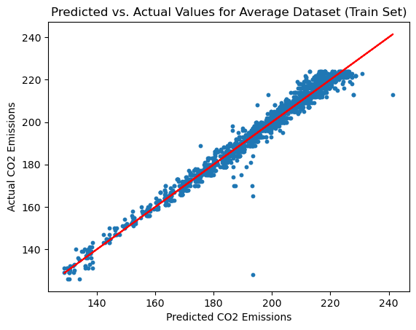
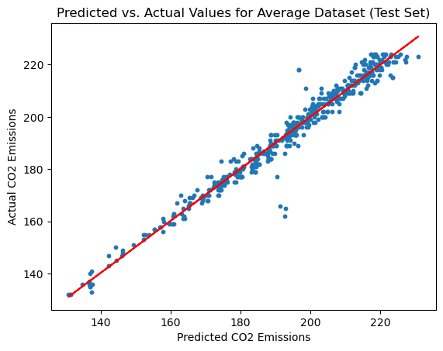
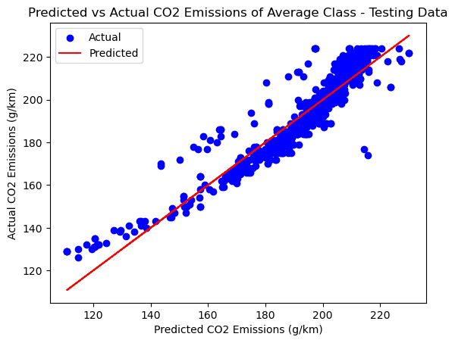
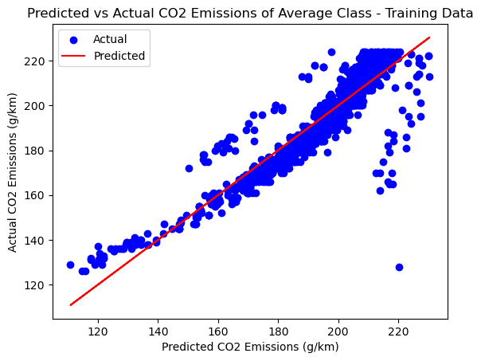
Avg Data Set
Linear Regression
Training Set:
Mean Squared Error (MSE): 65.21511126944438
R-squared (R2) Score: 0.8477595653883695
Testing Set:
Mean Squared Error (MSE): 59.849915750685575
R-squared (R2) Score: 0.8695023884700319
Higher MSE values suggest more prediction errors in this subdataset. R-squared indicates moderate variance explanation. Overall, linear regression model for "Average" CO2 class predicts emissions reasonably well.
Polynomial Regression
Training set :
MSE: 12.008774879829271
R-squared score: 0.9727011073946481
Testing set :
MSE: 14.874433653890435
R-squared score: 0.9652222554082805
Polynomial regression model on average CO2 dataset has good performance, with high R-squared scores (>0.9) and relatively low MSE scores. However, they are slightly higher than low CO2 dataset.

Slide 20
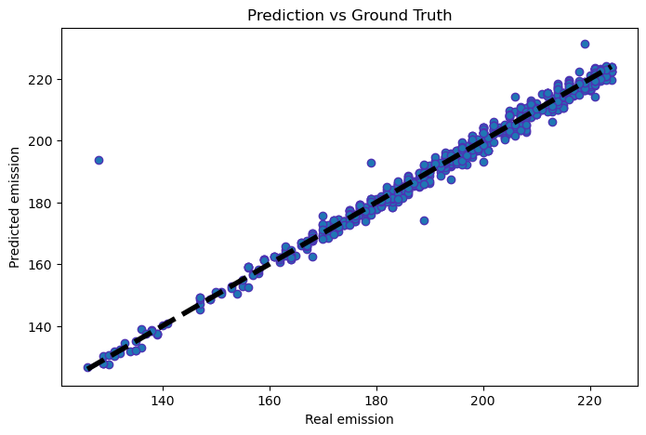
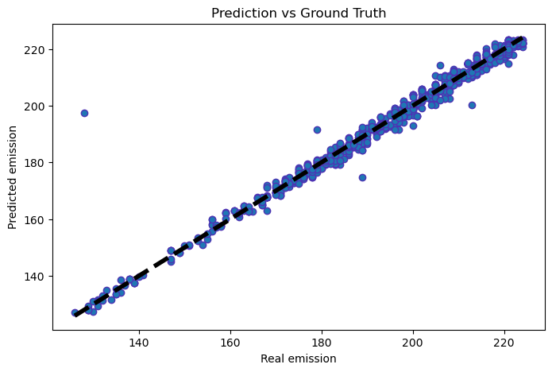
Avg Data Set
Random Forest Regression
R^2 score for train dataset = 0.9955
R^2 score for test dataset = 0.9782
Mean Squared Error train and test: 10.467966201388872 1.8685277346637952
Hyperparameter tuning didn't improve random forest regressor performance on "Average" CO2 dataset significantly. R-squared and MSE for train and test sets were similar before and after tuning, with only a slight increase in test set R-squared from 0.9781 to 0.9782.
XGBoost Regression
R^2 score for train dataset = 0.9946
R^2 score for test dataset = 0.9787
Mean Squared Error train and test: 10.196945293447534 2.252653531341953
XGBoost model has a good performance with an R^2 score of 0.9787 on the test dataset. The mean squared error for the test dataset is also reasonably low. It seems that the model is generalizing well to new data.

Slide 21
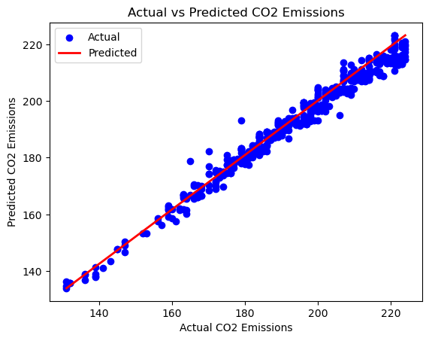
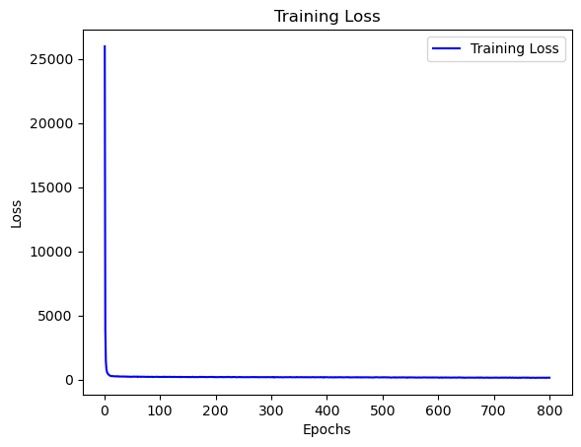
Avg Data Set
Neural Networks
Training Set:
R-squared (R2) Score: 0.9688745138494019
Mean Squared Error (MSE): 13.54604488013376
Testing Set:
R-squared (R2) Score: 0.9689845596141275
Mean Squared Error (MSE): 13.806733869808422
The model performs well on both sets, with R-squared close to 1, indicating high variance explanation. Low MSE suggests predictions are close to actual values.
It is capturing the underlying patterns and relationships in the data effectively, resulting in accurate predictions.
The ideal "L" shaped curve for the training loss demonstrates that the model is learning and improving over the epochs without overfitting. This is a positive indication of a well-trained neural network model.
Line connects most data points following pattern, indicating model captures relationship between input features and target variable well.

Slide 22
AVERAGE Dataset Results
Based on the results for the average CO2 dataset, the best models for predicting CO2 levels are Random Forest, Random Forest tuned, XGBoost, and XGBoost tuned, as they all have high R^2 scores for both the train and test datasets and low MSE values for the test dataset. The neural network model also has a relatively high R^2 score but a higher MSE value, indicating it may not perform as well as the other models. The linear and polynomial models have lower R^2 scores and higher MSE values, indicating they may not be as effective in predicting CO2 levels for this dataset.
MODEL | TRAIN_R2 | TEST_R2 | TRAIN_MSE | TEST_MSE
LINEAR | 0.84 | 0.86 | 65.21 | 59.84
POLYNOMIAL | 0.97 | 0.96 | 12.00 | 14.87
RANDOM FOREST | 0.99 | 0.97 | 10.47 | 1.86
RANDOM FOREST TUNED | 0.99 | 0.97 | 10.46 | 1.86
XGBOOST | 0.99 | 0.97 | 10.69 | 1.57
XGBOOST TUNED | 0.99 | 0.97 | 10.19 | 2.25
NEURAL NETWORKS | 0.96 | 0.96 | 13.54 | 13.80

Slide 23
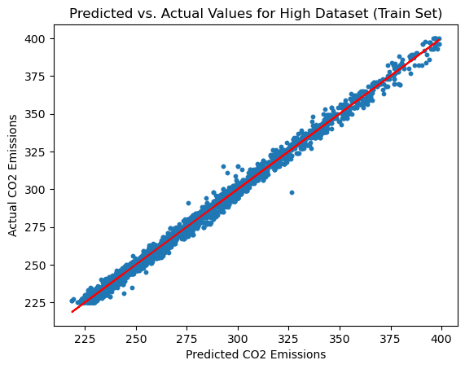
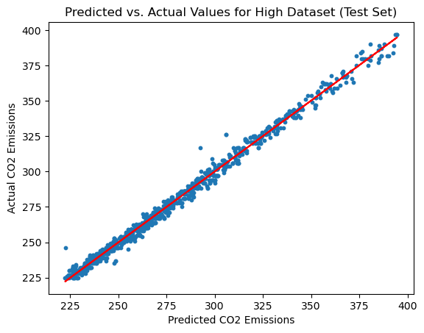
High Dataset
Linear Regression : Training Set:
Mean Squared Error (MSE): 284.15411637239686
R-squared (R2) Score: 0.8216362429372042
Testing Set:
Mean Squared Error (MSE): 269.75731263451
R-squared (R2) Score: 0.8239811318717458
After Applying Lasso Regression :
Training Set:
Mean Squared Error (MSE): 284.1548638200447
R-squared (R2) Score: 0.8216357737637416
Testing Set:
Mean Squared Error (MSE): 269.74516585459264
R-squared (R2) Score: 0.8239890577456805
After Applying Ridge Regression:
Training Set:
Mean Squared Error (MSE): 284.1541163829411
R-squared (R2) Score: 0.8216362429305856
Testing Set:
Mean Squared Error (MSE): 269.75729526467603
R-squared (R2) Score: 0.8239811432057073
The performance of the linear regression model does not improve after applying Lasso and Ridge regression as well.

Slide 24
High Dataset
Polynomial regression:
Training set performance:
MSE: 38.50272942402895
R-squared score: 0.9753939386736717
Testing set performance:
MSE: 44.523952447981024
R-squared score: 0.9730323213040046
After applying Lasso Regression :
Training set performance:
MSE: 9.421299342343785
R-squared score: 0.993979100368746
Testing set performance:
MSE: 12.091209624744417
R-squared score: 0.9926764844925438
Using the Lasso regressor, and changing the degree to 3 has improved the model's performance on both the training and testing sets compared to the previous models. The lower MSE and higher R-squared scores suggest that the model is fitting the data better and capturing more of the variance in the target variable.

Slide 25
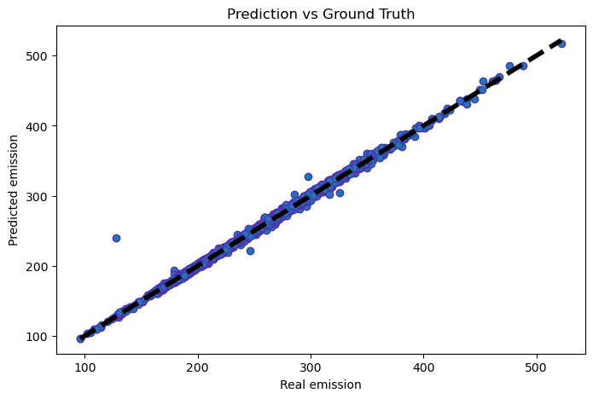
High Dataset
Random forest Regression:
R^2 score for train dataset = 0.9983
R^2 score for test dataset = 0.9959
Mean Squared Error train and test: 5.887114569835683 13.586995686247
After tuning:
R^2 score for train dataset = 0.9983
R^2 score for test dataset = 0.9958
Mean Squared Error train and test: 5.842181725312405 13.940027545850539

Slide 26
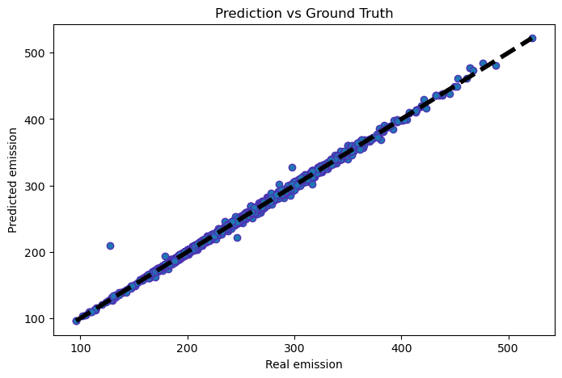
High dataset
XG Boost:
R^2 score for train dataset = 0.9984
R^2 score for test dataset = 0.997
Mean Squared Error train and test: 5.605686377212859 9.952730400143551
After Tuning :
R^2 score for train dataset = 0.9984
R^2 score for test dataset = 0.9967
Mean Squared Error train and test: 5.4872563247837185 11.120903013232809

Slide 27
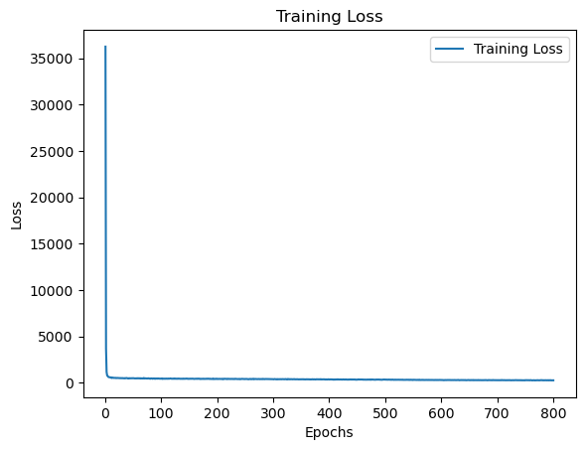
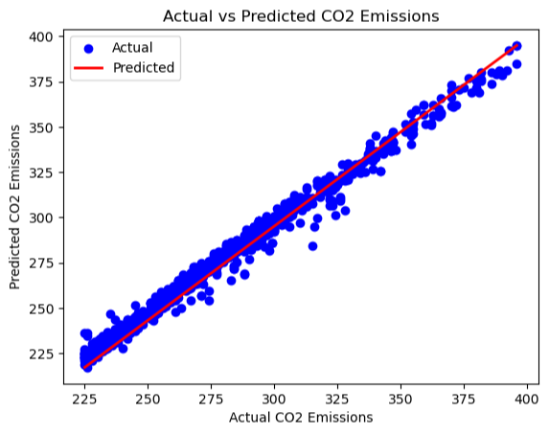
High dataset
Neural Networks
Training Set:
R-squared (R2) Score: 0.9688745138494019
Mean Squared Error (MSE): 13.54604488013376
Testing Set:
R-squared (R2) Score: 0.9689845596141275
Mean Squared Error (MSE): 13.806733869808422

Slide 28
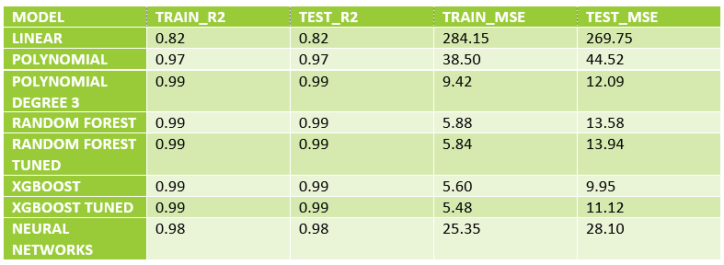
HIGH Dataset Results
Based on these results, it seems that Random Forest, XGBoost, and Polynomial Regression with degree 3 are all good models for predicting CO2 levels in the high class. Random Forest (both regular and tuned) achieved high R2 scores of 0.99 on both train and test datasets, with low mean squared errors. XGBoost (both regular and tuned) also achieved similar high R2 scores of 0.99 on both train and test datasets, with even lower mean squared errors for the regular model. Polynomial Regression with degree 3 achieved a high R2 score of 0.99 on both train and test datasets, with a relatively low mean squared error.

Slide 29
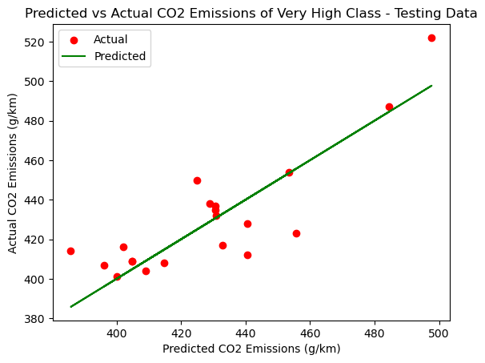
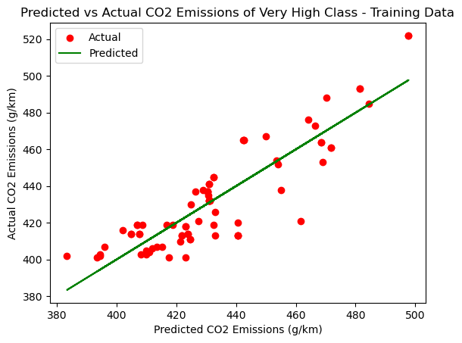
VERY HIGH DATASET
Linear Regression : Training Set:
Mean Squared Error (MSE): 179.0082451760012
R-squared (R2) Score: 0.775651719609745
Testing Set:
Mean Squared Error (MSE): 244.53518710183138
R-squared (R2) Score: 0.716325538220264

Slide 30
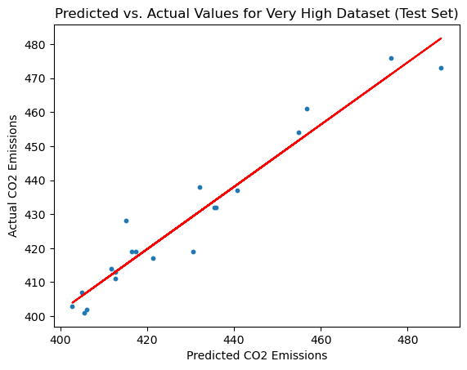
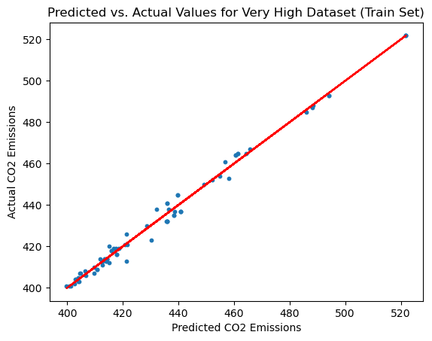
VERY HIGH DATASET
Polynomial regression:
Training set performance:
MSE: 2.7667358042433476
R-squared score: 0.9968839148958866
Testing set performance:
MSE: 87315.28138243438
R-squared score: -176.26831529648035
After applying Lasso Regression :
Training set performance:
MSE: 7.950360968833386
R-squared score: 0.9910457654289541
Testing set performance: MSE: 34.40281473163061
R-squared score: 0.9301550780988497

Slide 31
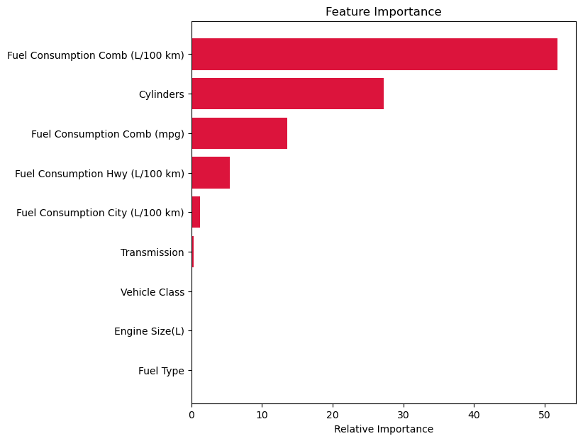
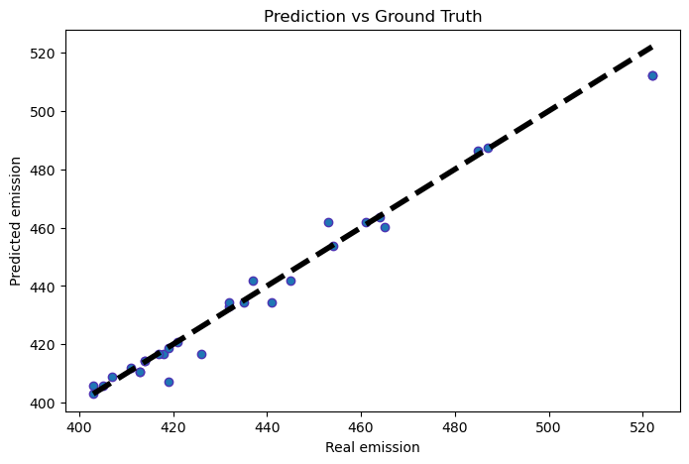
VERY HIGH DATASET
Random forest Regression:
R^2 score for train dataset = 0.5456
R^2 score for test dataset = 0.7362
Mean Squared Error train and test: 315.46993547569485 ,271.6978634786017
After tuning:
R^2 score for train dataset = 0.9875
R^2 score for test dataset = 0.9794
Mean Squared Error train and test: 8.671360847105527 ,21.209066903571443

Slide 32
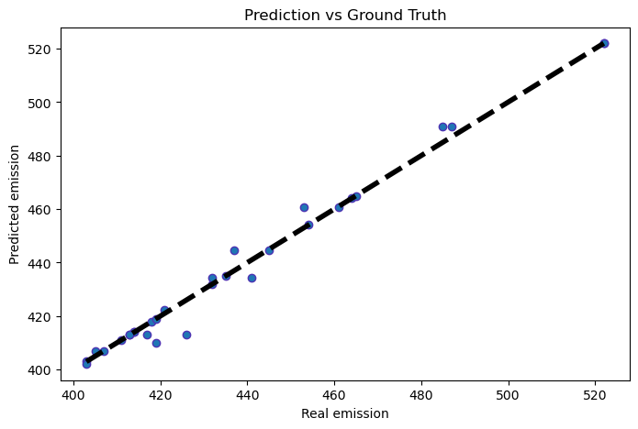
VERY HIGH DATASET
XG Boost:
R^2 score for train dataset = 0.9956
R^2 score for test dataset = 0.9853
Mean Squared Error train and test: 3.0404437595348366 15.191108451752614
After Tuning :
R^2 score for train dataset = 0.9956
R^2 score for test dataset = 0.984
Mean Squared Error train and test: 3.0460915271576274 16.492933161618808

Slide 33
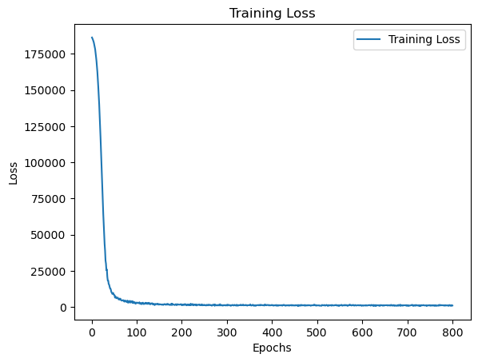
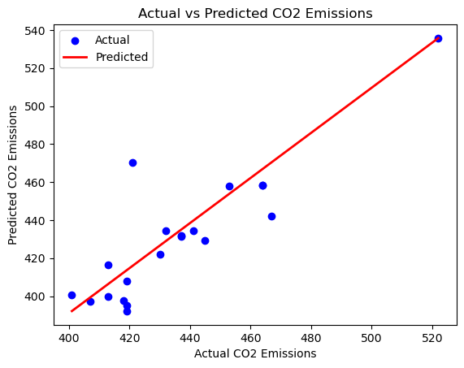
VERY HIGH DATASET
Neural Networks:
Training Set:
R-squared (R2) Score: 0.906249692283573
Mean Squared Error (MSE): 77.23627730437482
Testing Set:
R-squared (R2) Score: 0.6077397400447472
Mean Squared Error (MSE): 292.50455324603246

Slide 34
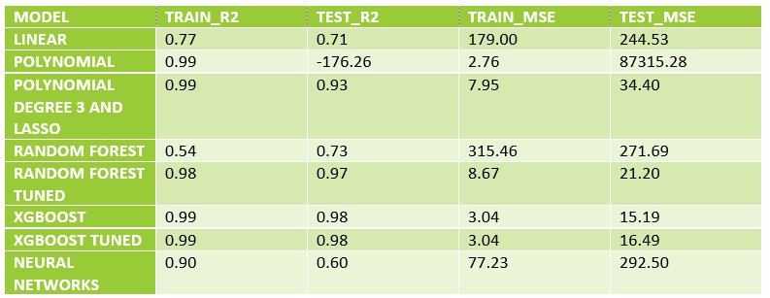
VERY HIGH Dataset Results
Based on the results, it appears that the XGBoost model (both the standard and tuned versions) performed the best on the very high CO2 dataset, with the highest R2 scores and lowest mean squared errors. The polynomial model with degree 3 and Lasso regularization also performed well with high R2 scores and relatively low mean squared errors. The other models (linear, polynomial, random forest, and neural networks) did not perform as well on this dataset. It's worth noting that the neural network model had a significantly lower R2 score and higher mean squared error compared to the other models.

Slide 35
CONCLUSION & FUTURE SCOPE
In this project, we used a dataset of vehicle CO2 emissions and various features such as fuel consumption and engine size to predict the CO2 emissions of a vehicle.
We used exploratory data analysis to understand the distribution of the data and the relationship between the features and the target variable.
We built different models to predict the amount of CO2 emitted from vehicles and see which model is able to predict the different classes in a better way.
The current models could be improved by incorporating more features, such as the weight of the vehicle, which could further improve its accuracy.
The model could also be used to predict the impact of policy changes on vehicle emissions, such as the introduction of stricter emissions standards or the adoption of electric vehicles.
The project could be extended to include a larger dataset, including vehicles from different regions and manufacturers, to provide a more comprehensive analysis of vehicle emissions.

Slide 36

REFERENCES
Canada Gazette – Regulations Amending the Passenger Automobile and Light Truck Greenhouse Gas Emission Regulations. (n.d.). Canada Gazette &Ndash; Regulations Amending the Passenger Automobile and Light Truck Greenhouse Gas Emission Regulations. https://gazette.gc.ca/rp-pr/p2/2014/2014-10-08/html/sor-dors207-eng.html

Slide 37
THANK YOU

